Slide 1


MICROVASCULAR IMAGING
ROBERT BARD, MD, DABR, FAIUM, FASLMS
Director, Bard Diagnostic Imaging
THE ANGIOFOUNDATION 501(c)3, NYC
Founder
SOCIETE FRANCAISE DE RADIOLOGIE, PARIS
International Contributor
©Copyright 2024 - Robert. L. Bard, MD. All Rights Reserved.

Slide 2

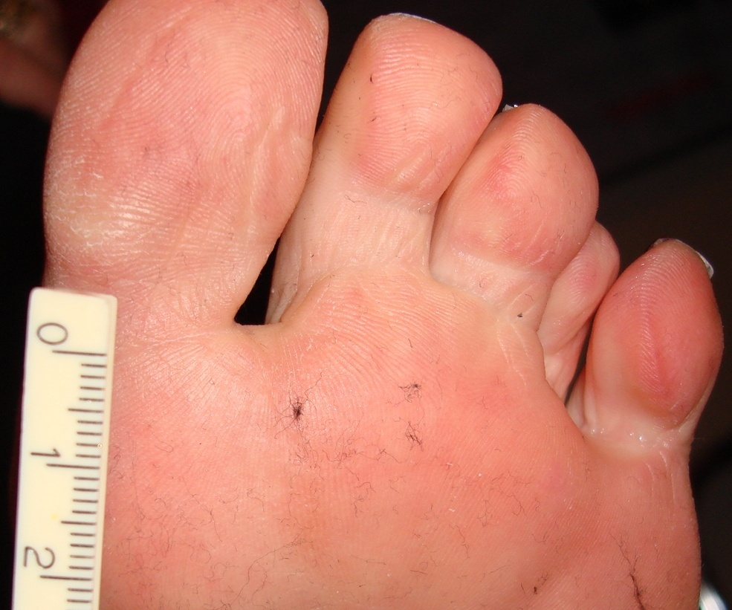
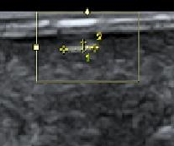
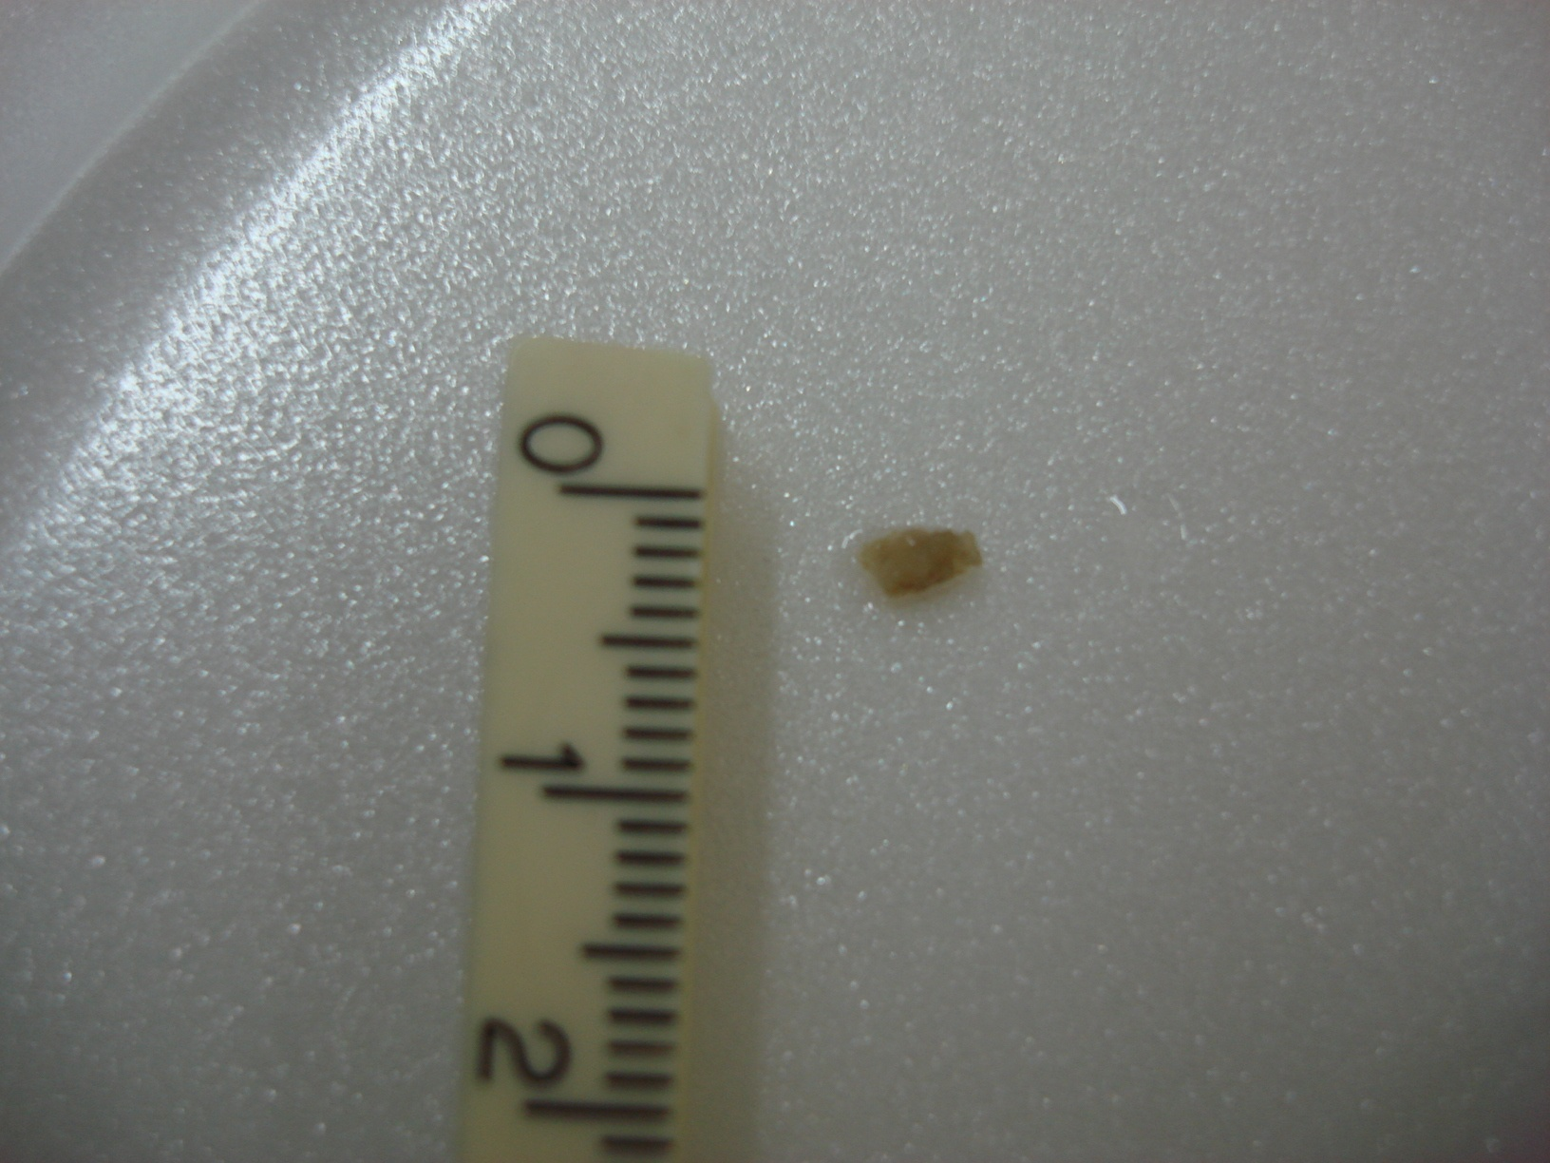
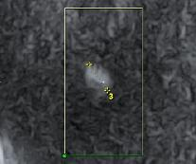
INTRADERMAL FOREIGN BODY MIMICKING PLANTAR WART
NON RADIO-OPAQUE WOOD MEASURING 0.4 X 3.1 MM
2D LINEAR SONOGRAM
3D CORONAL SONOGRAM

Slide 3
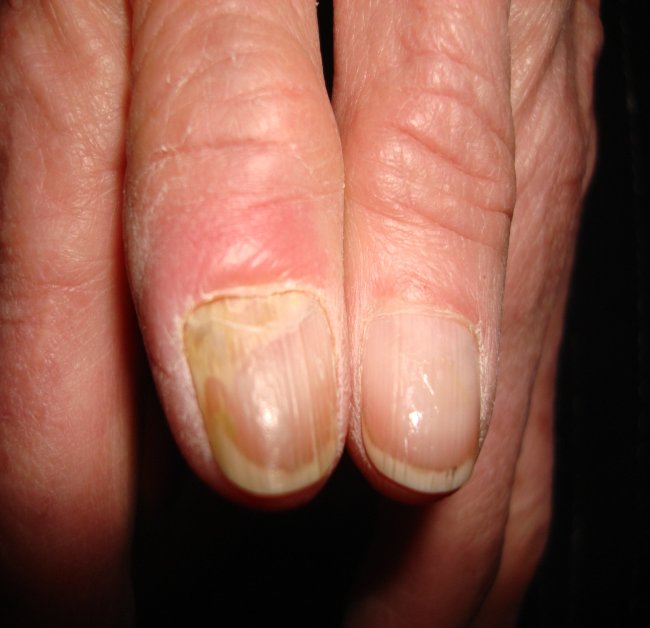
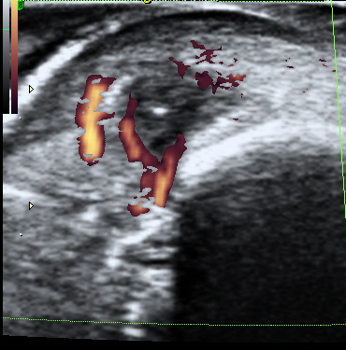
FOREIGN BODY
NAIL PLATE
BONEY CORTEX
1ST DIGIT
FOREIGN BODY 3MM DEEP TO SKIN SURFACE & LATERAL TO NAIL

Slide 4
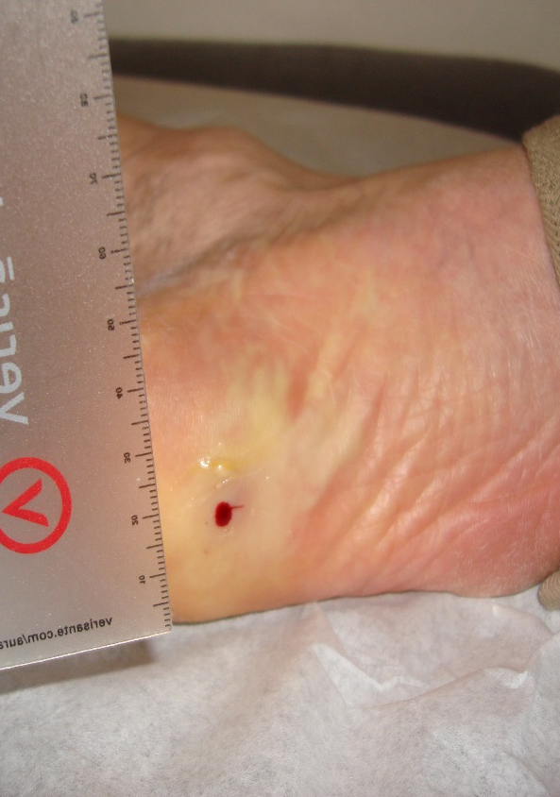
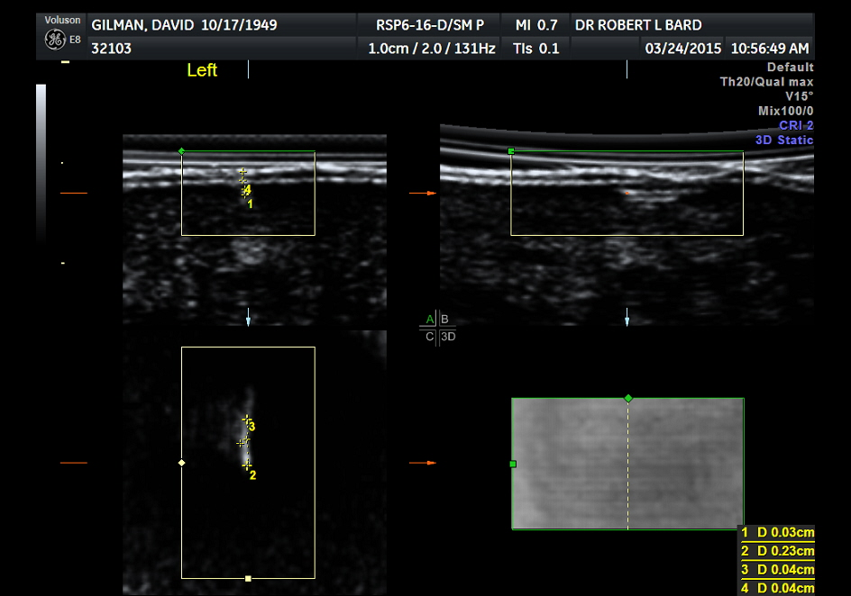
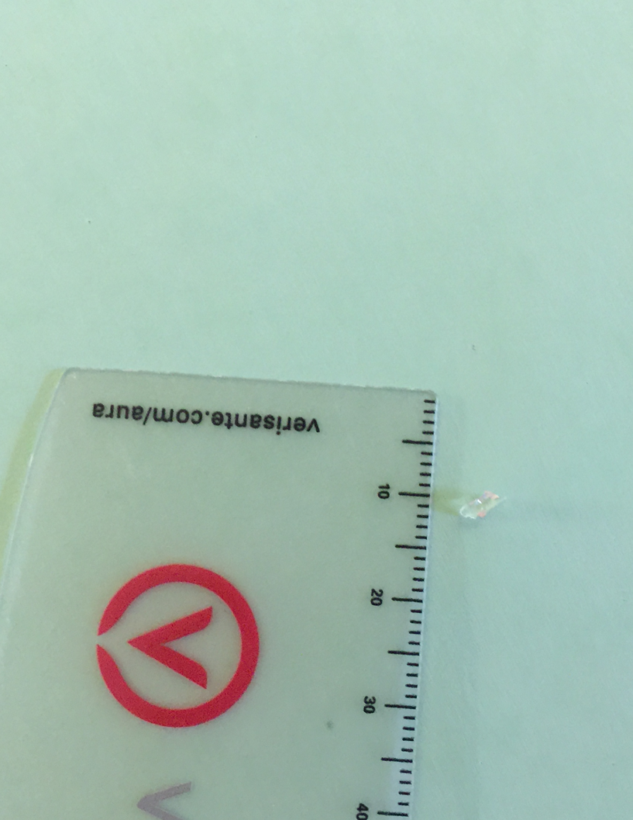
FB MISSED AFTER 1ST EXCISION
2D
3D
NON RADIO-OPAQUE GLASS REMANTS FOLLOWING SURGICAL REMOVAL

Slide 5
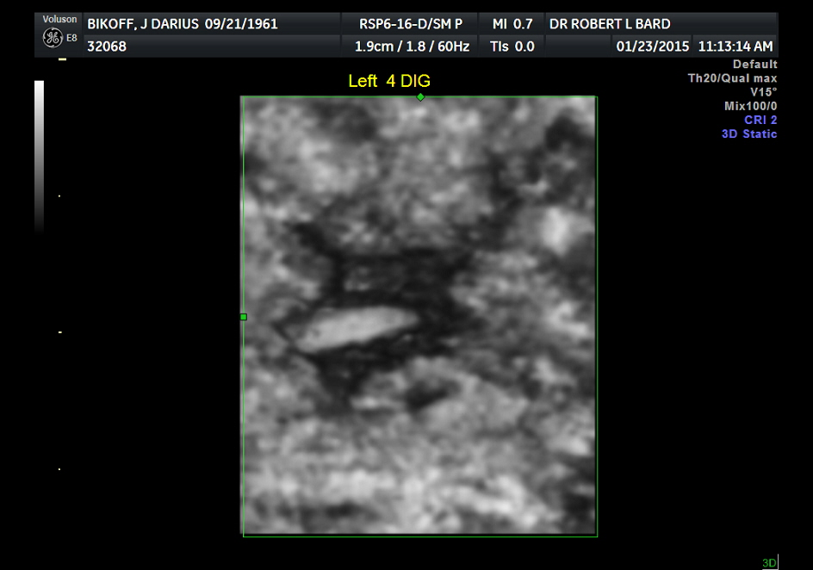
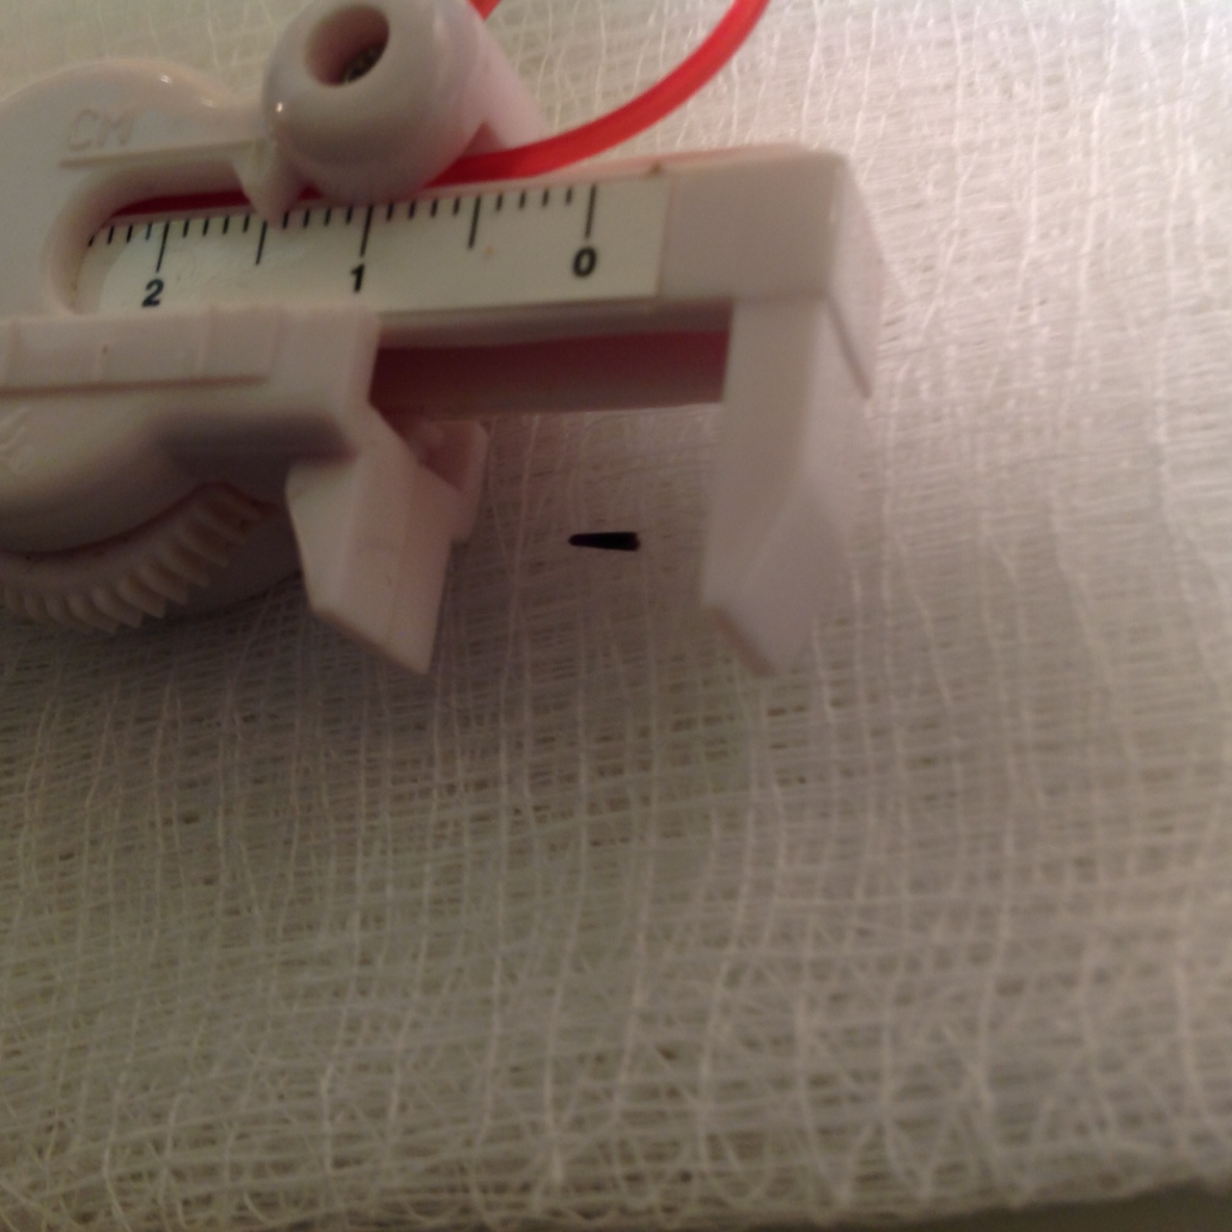
1X4 MM SEA URCHIN SPINE
MAY NOT BE RADIOGRAPHICALLY CALCIFIED
REACTIVE FIBROTIC SHELL (BLACK) SURROUNDS THORN (WHITE)

Slide 6
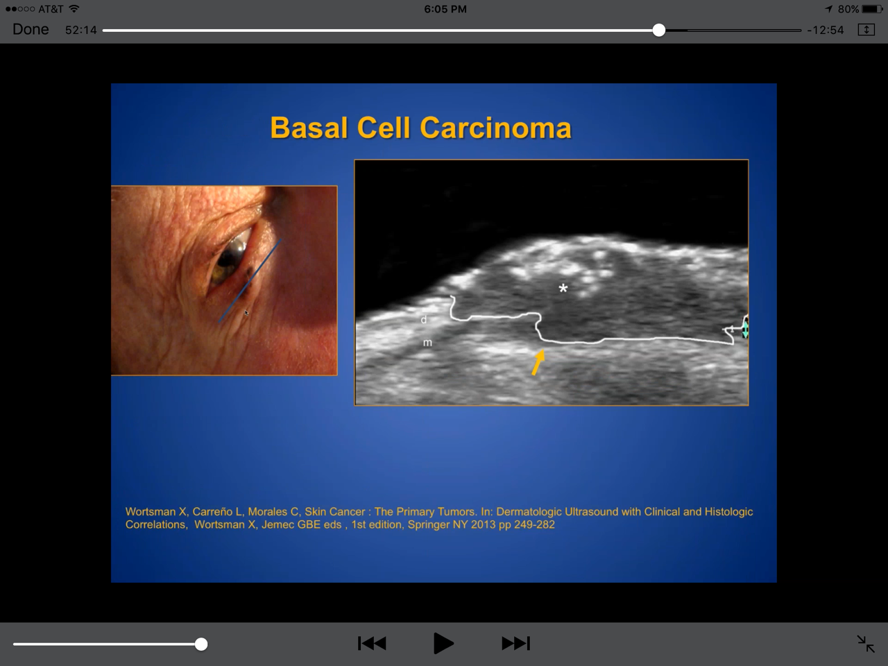
BCC ORBITAL MUSCLE INVASION
m
m = ORBICULARIS MUSCLE IMMEDIATELY SUBDERMAL

Slide 7
DEEP BCC NASAL
NORMAL NASAL CARTILAGE (c) ERODED LEFT CARTILAGE-ARROW

Slide 8
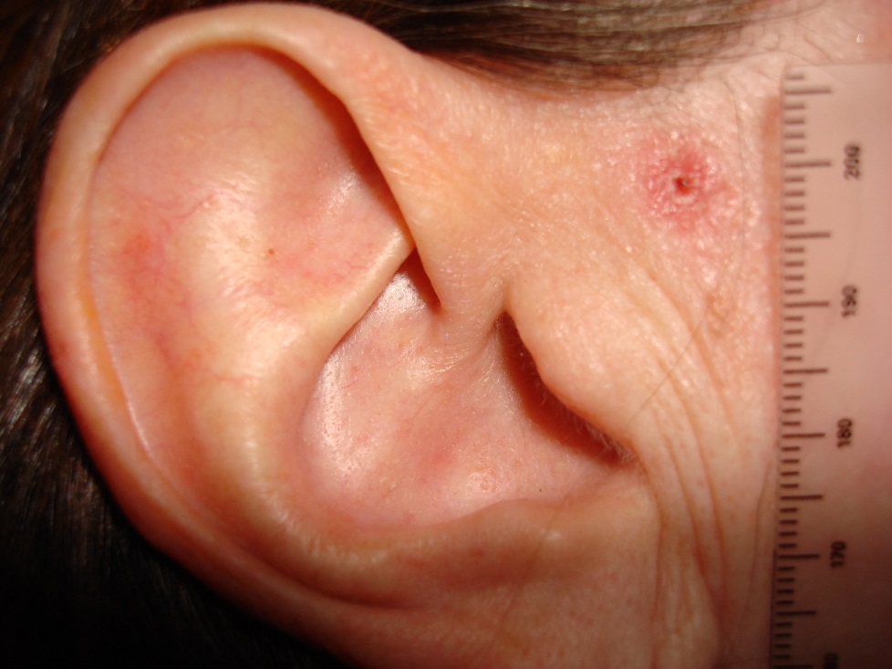
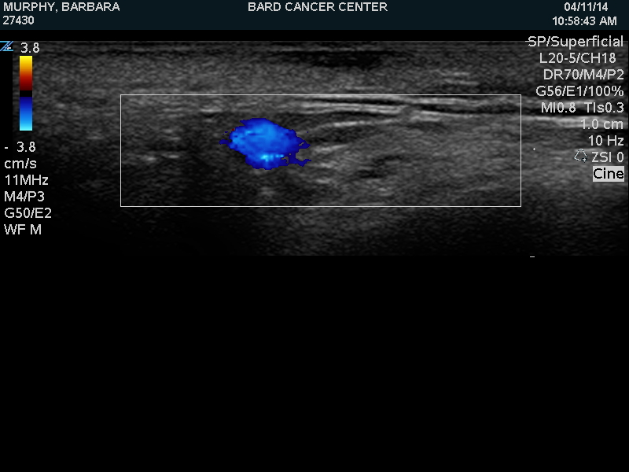
BCC 3 MM FROM FACIAL NERVE
Depth
2.1 mm
Facial Nerve
FACIAL VEIN

Slide 9
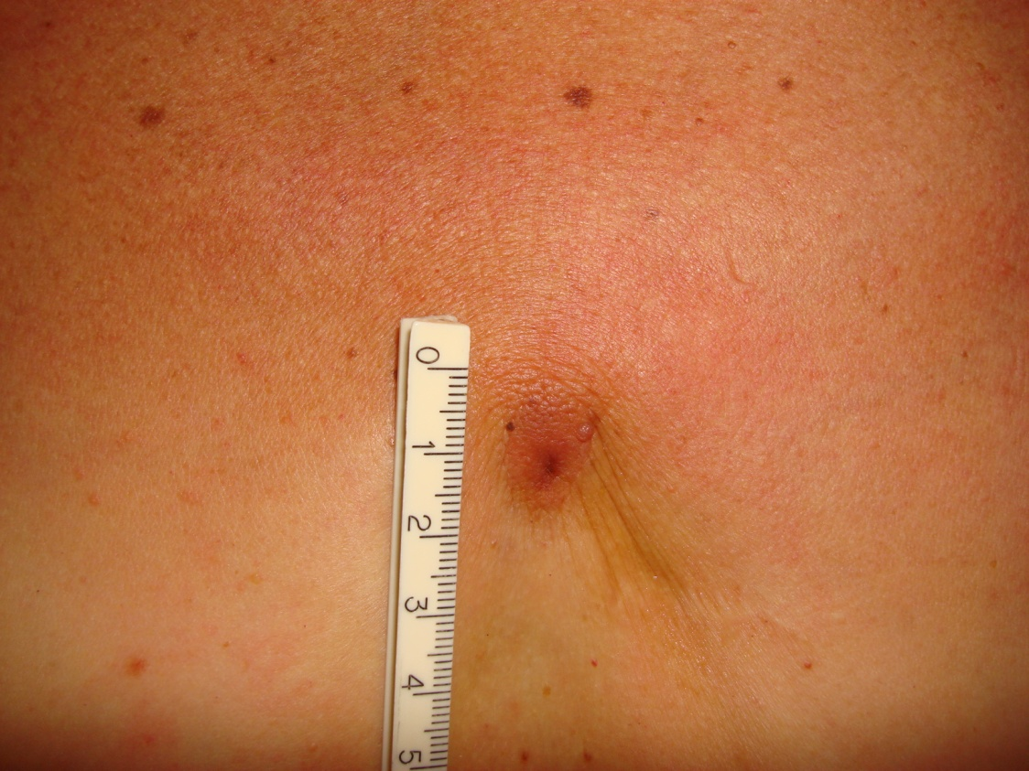
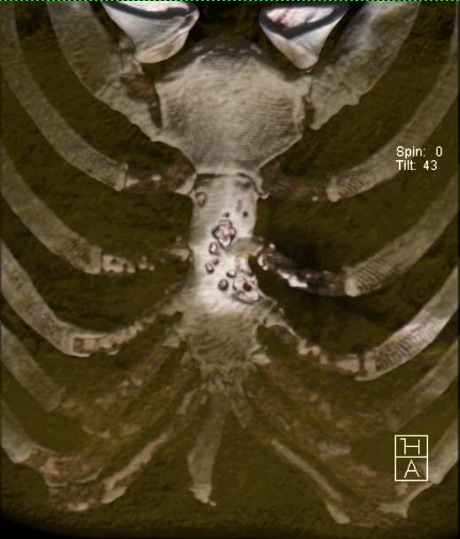
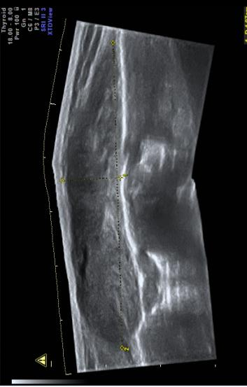
DERMAL POSTOP LESION
DIAGNOSED AS KELOID
STERNAL BONY EROSION
DUE TO INVASIVE BCC
DERMAL LESION IS 1 CM SUBCUT MASS 3X6 CM
S
T
E
R
N
U
M
S
I
D
E
V
I
E
W
M
I
D
L
I
N
E
M
A
S
S
E
R
O
S
I
O
N
STERNUM
S
K
I
N
? KELOID
POSTOP
SITE

Slide 10
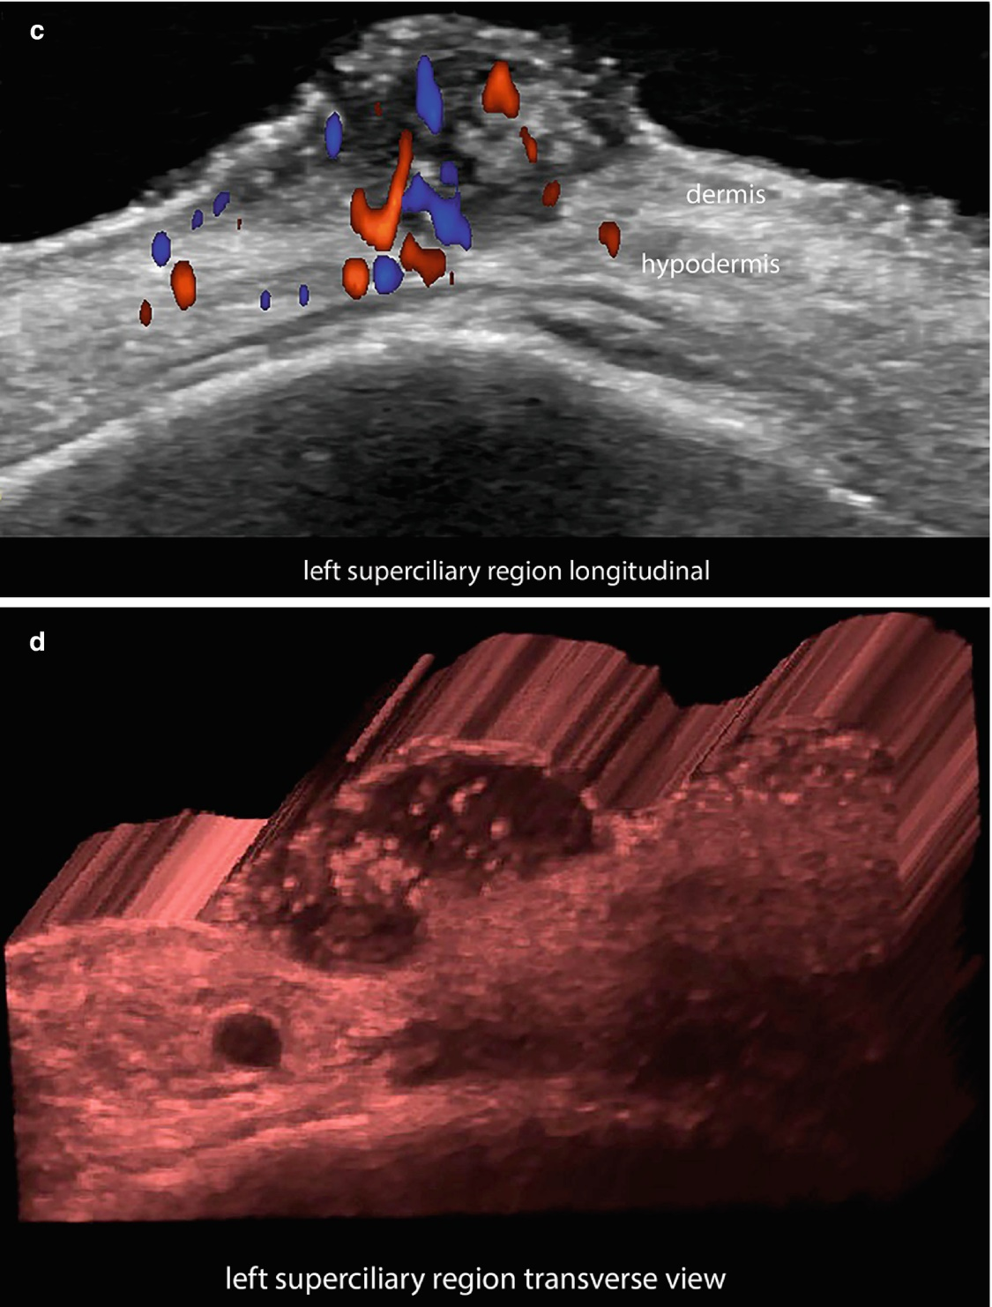
TUMOR AGGRESSION - BCC

Slide 11
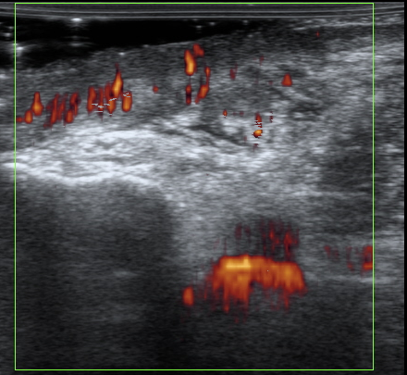
SKIN GRAFT REJECTION BY RESIDUAL SCC
TIBIA
GENICULATE ARTERY

Slide 12
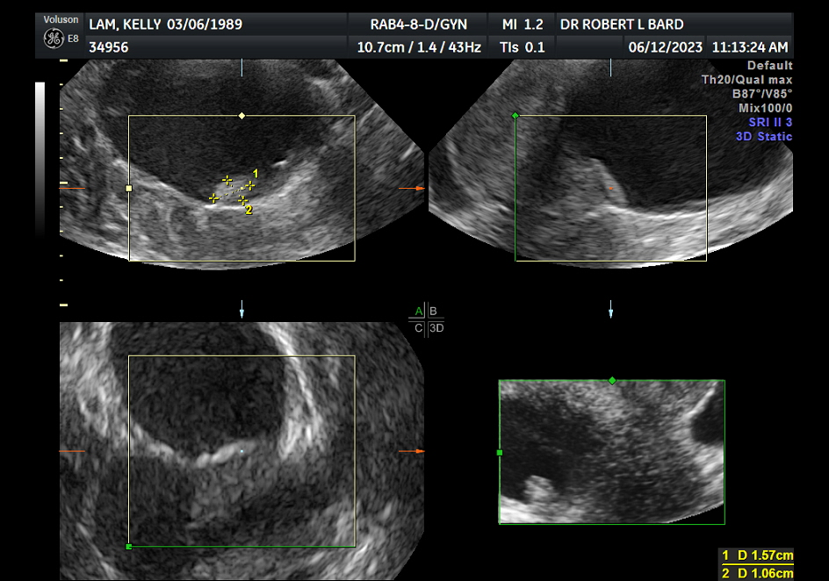
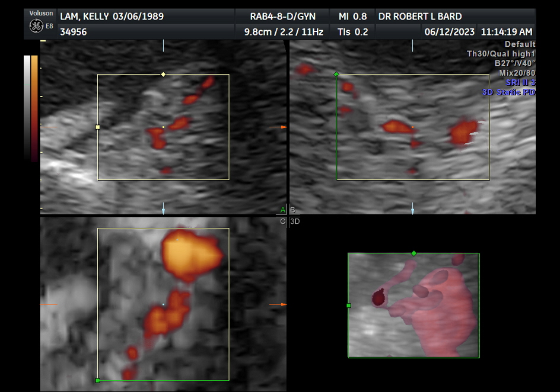
ENDOMETRIOSIS avascular cyst nodule and wall = no cancer 13% vascular pedicle to cyst = therapy marker
pedicle to cyst
3 D Image

Slide 13
DYNAMIC CONTRAST -ENHANCED ULTRASOUND (DCE-US)
AND MELANOMA: EARLY EVALUATION OF RESPONSE AFTER ISOLATED LIMB PERFUSION
L Chami*, A Cavalcanti**, B Benatsou*,
S Koscielny***, M Chebil* , N Lassau*
Institut Gustave Roussy, Villejuif France
Imaging Department *; Surgical Department**;
Statistics Unit***

Slide 14
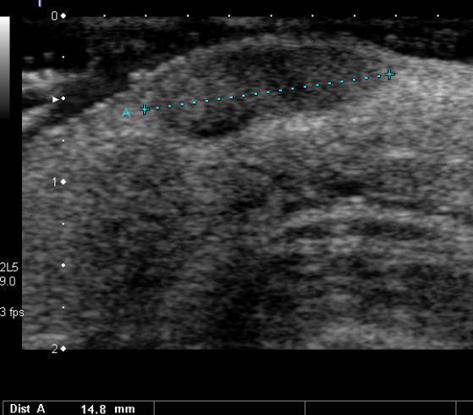
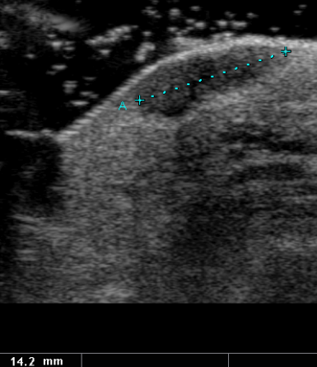
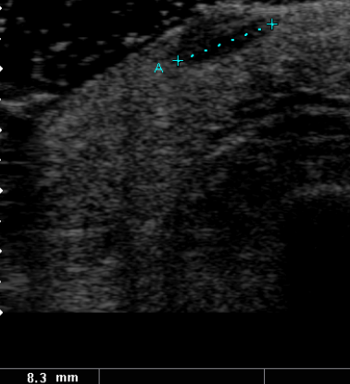
Mr L, 66 yrs right ankle melanoma (1997) local in transit recurrent lesions (2008) : responder (decrease of volume>50% without new lesions)
Man
Before treatment
D+7
3 months

Slide 15
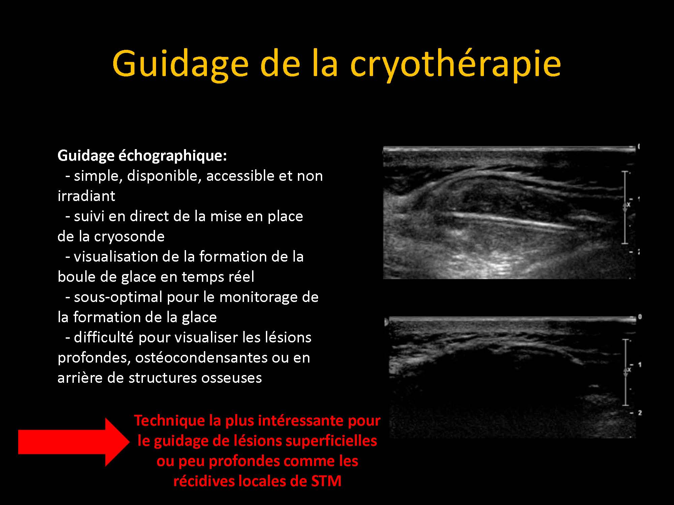

Slide 16
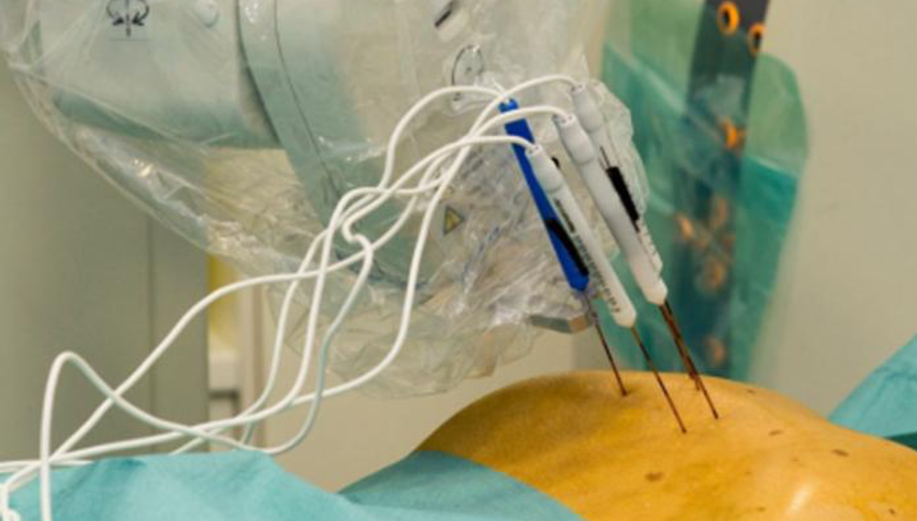
ULTRASOUND GUIDED R-F TUMOR ABLATION
THERMAL ABLATION BY CT, ULTRASOUND, MRI USED WORLD-WIDE

Slide 17
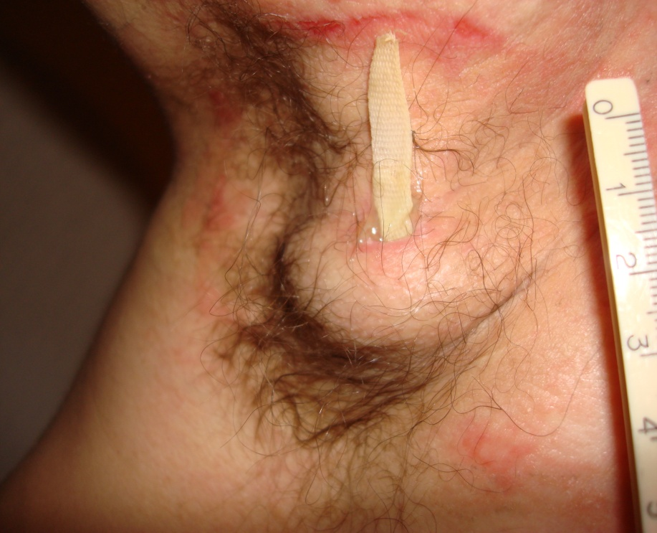
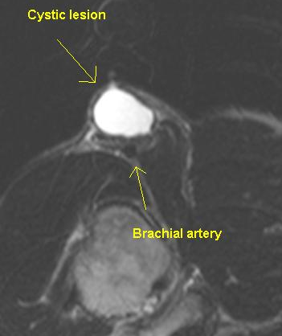
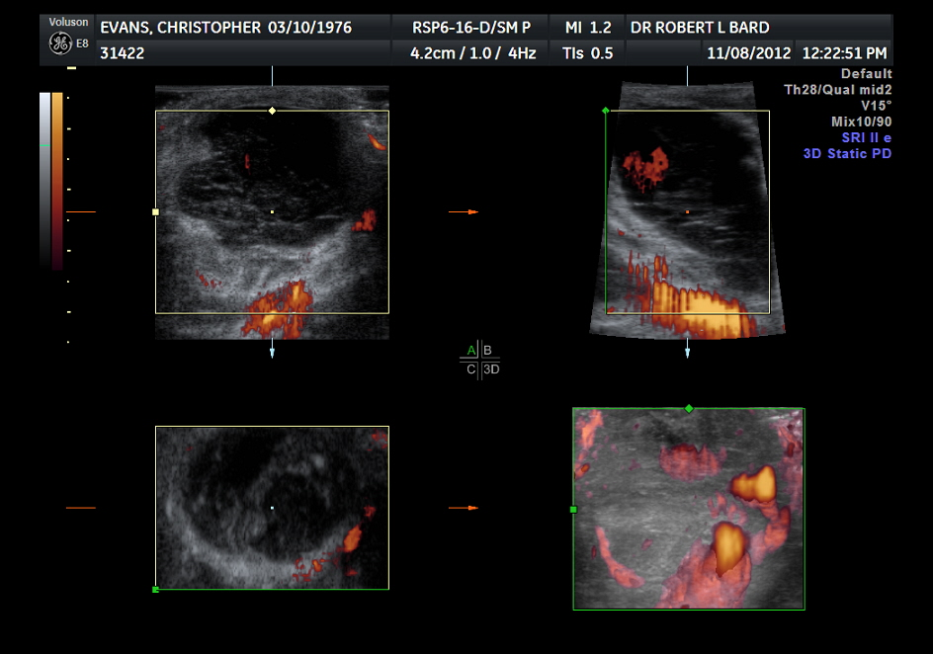
POSTOP LYMPHOCELE
CYST
NOTE ADJACENT BRANCH OF BRACHIAL ARTERY RED ARROW
CAUSES FALSE POSITIVE ON SNLB SCINTOGRAPHY

Slide 18
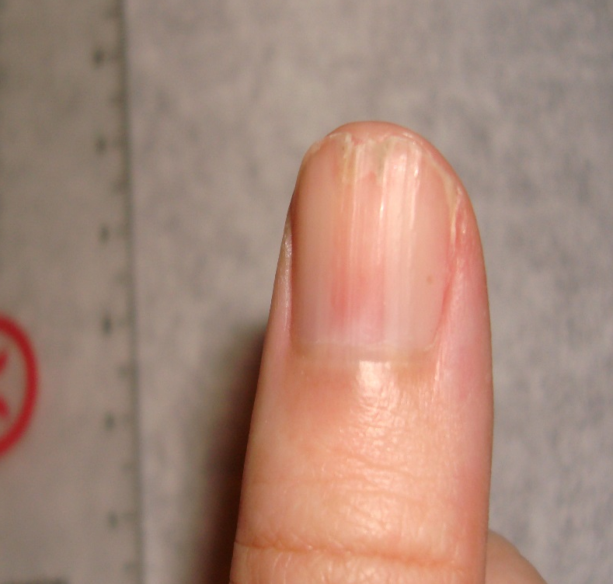
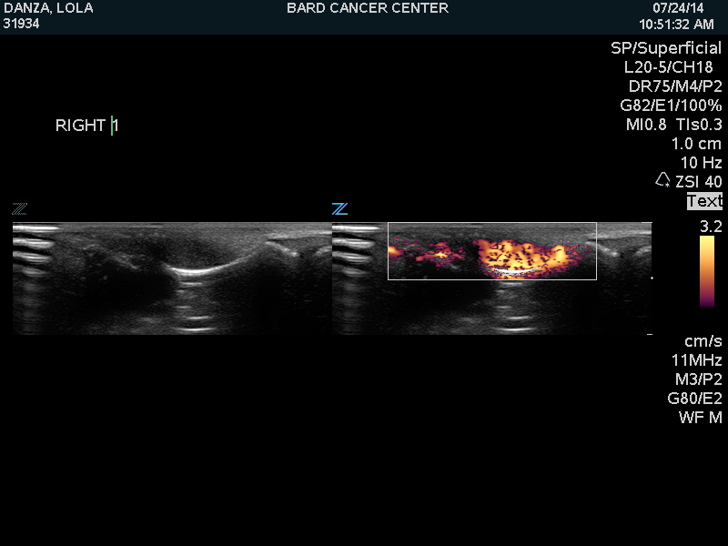
GLOMUS TUMOR
ERYTHRONYCHIA 5 YRS
CURVILINEAR BONY REMODELLING HYPEREMIA
SONOGRAM DOPPLER SCAN

Slide 19
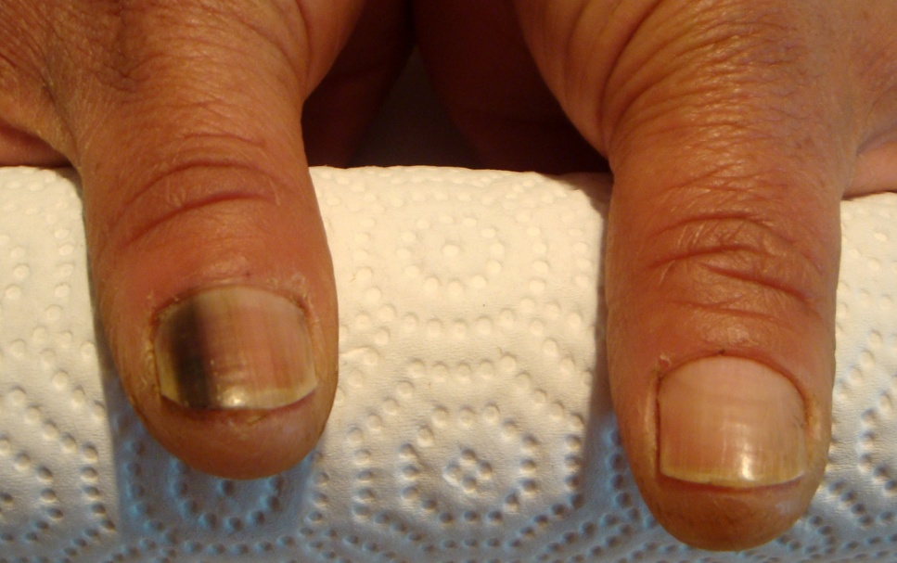
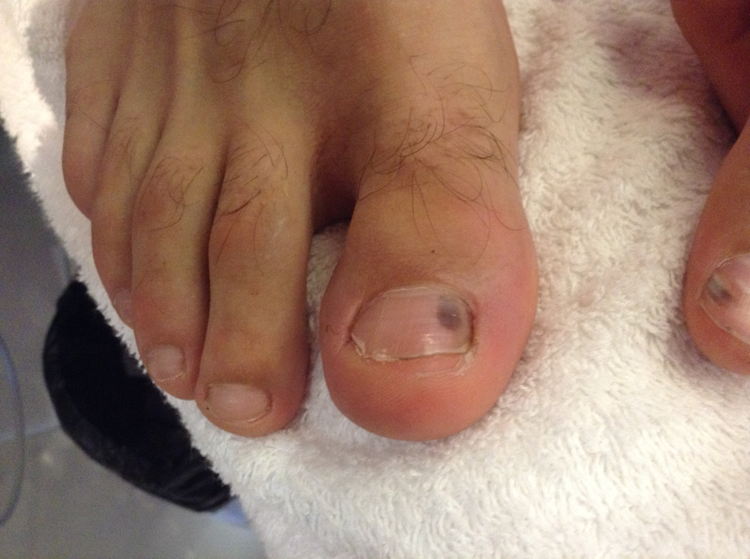
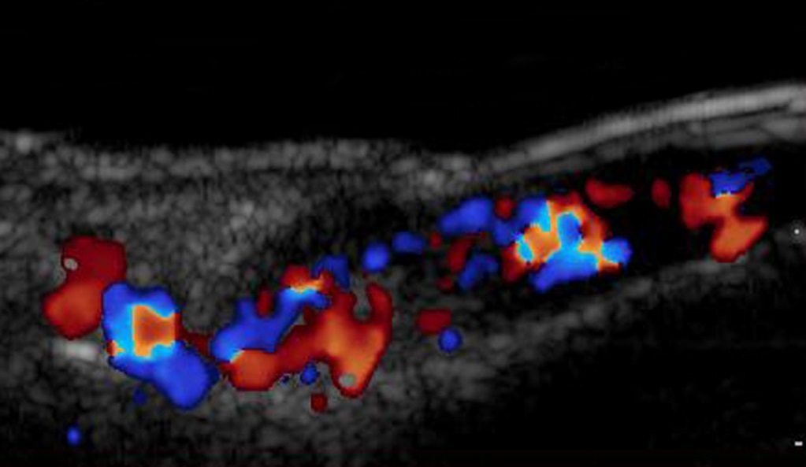
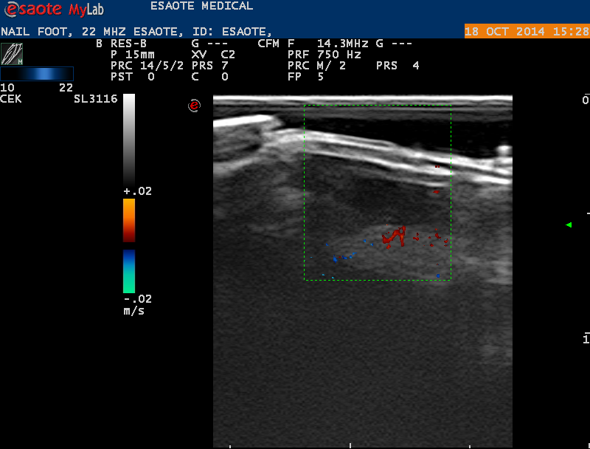
NAIL HEMATOMA?
MALIGNANT MELANOMA SOCCER PLAYER FORGOT INJURY
Tumor Arteries & Veins
Absent Blood Flow
Peripheral Vessels

Slide 20
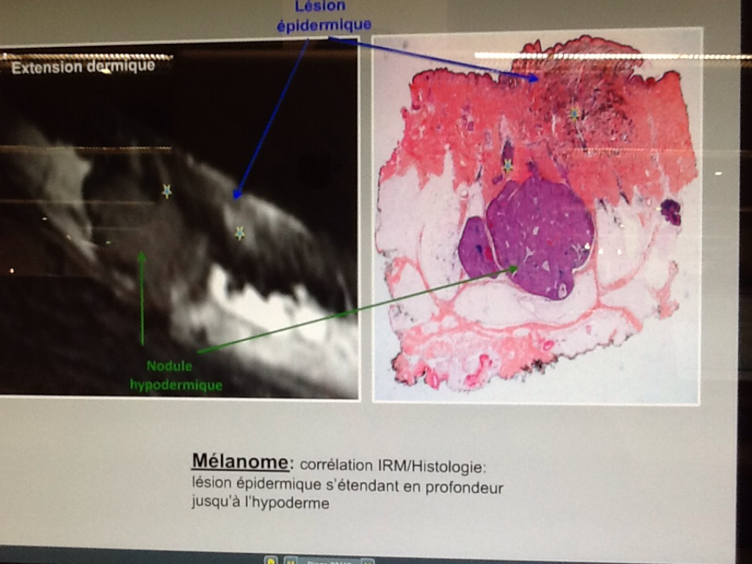
METASTATIC MELANOMA
SHAVE BIOPSY
PLANE
DEEP
METASTASIS
NODE OUTSIDE SHAVE OR PUNCH BIOPSY FIELD

Slide 21
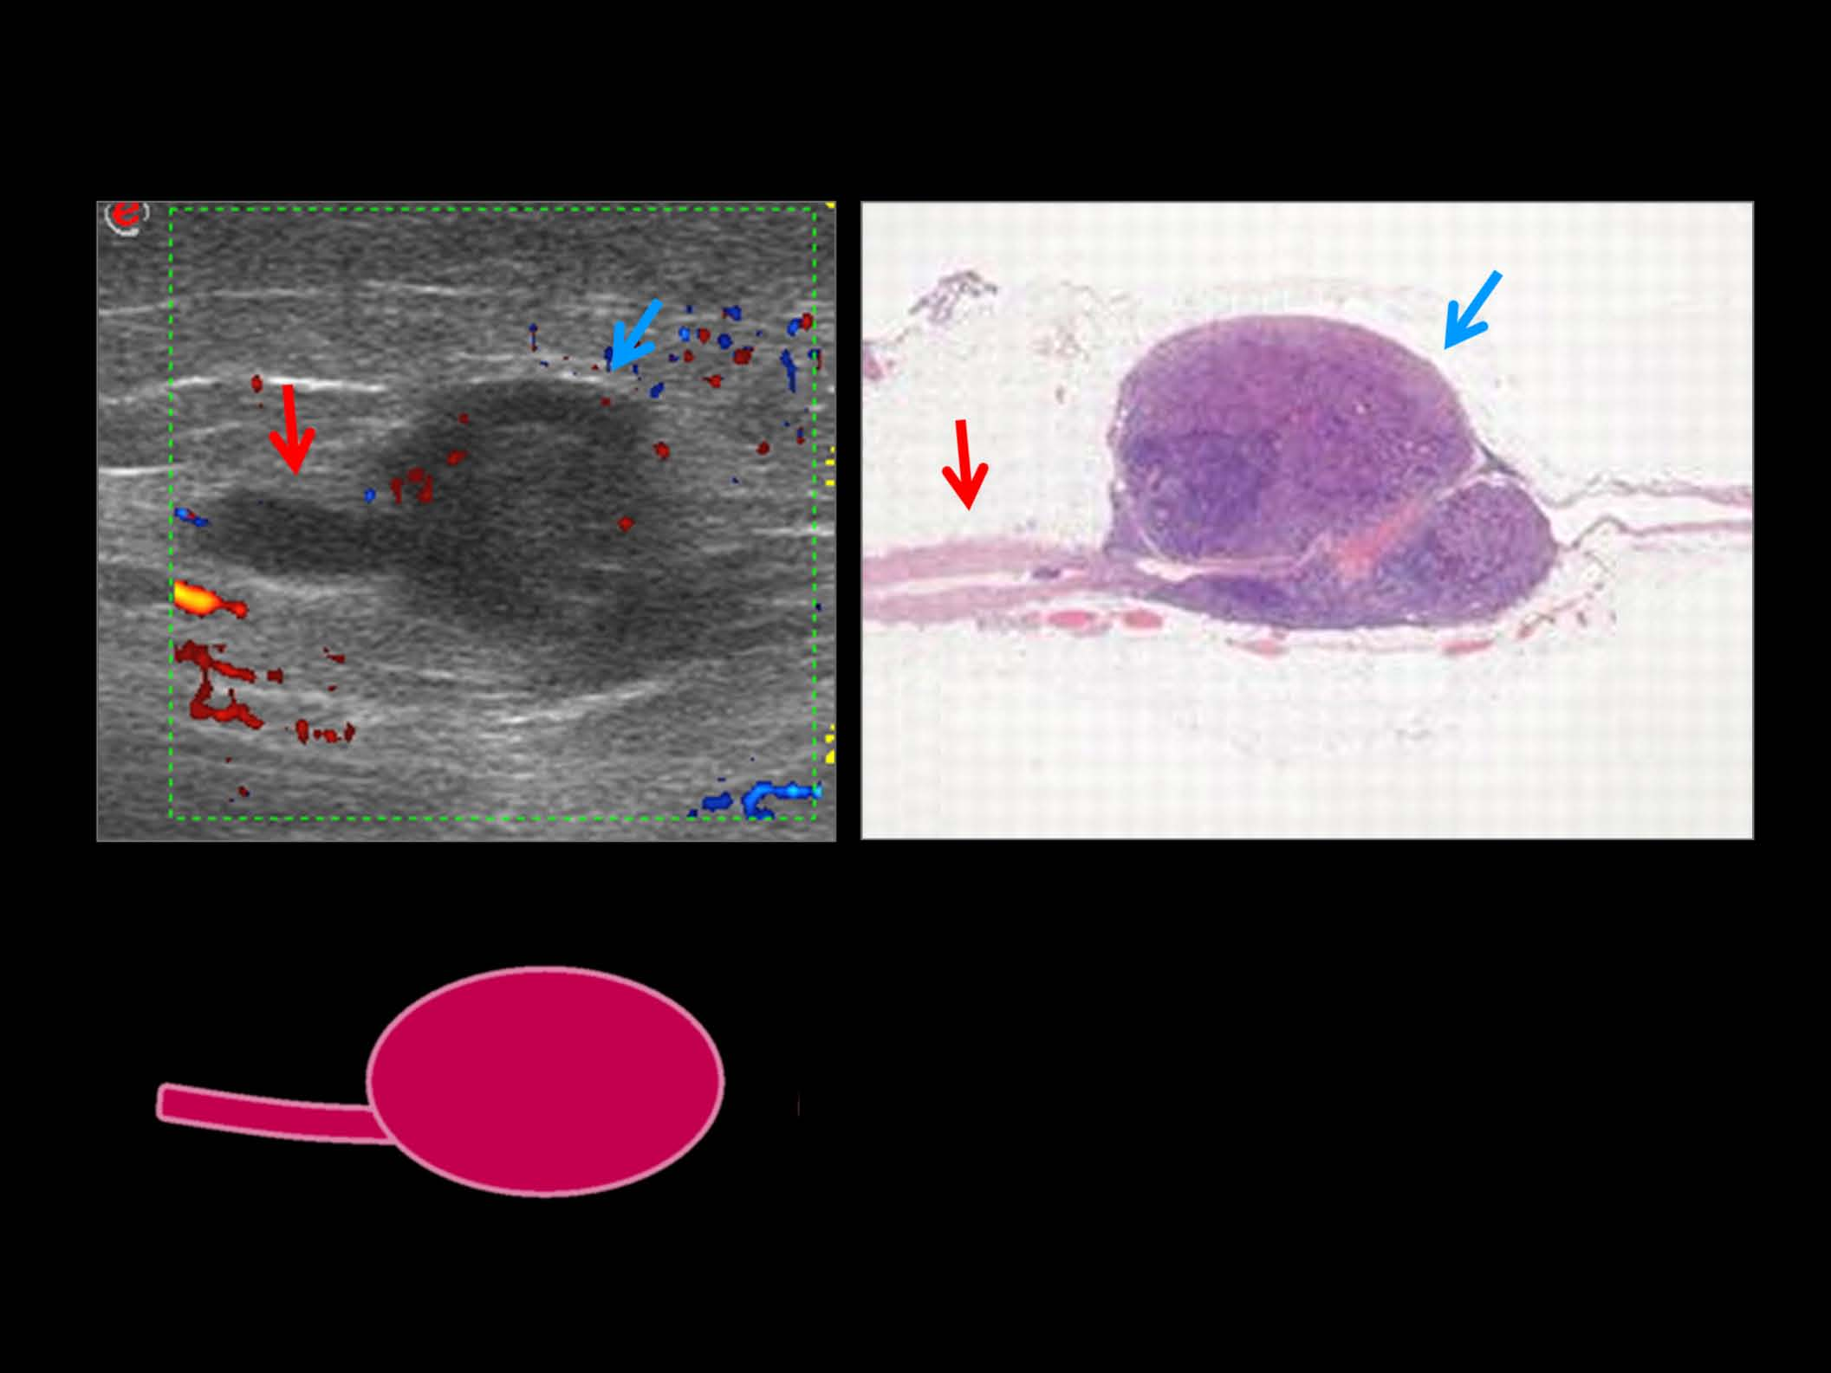
TAIL SIGN OF MELANOMA
DISTINCTIVE ULTRASOUND IMAGE PATTERN OF IN TRANSIT METASTASES

Slide 22
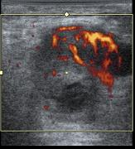
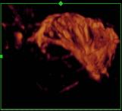
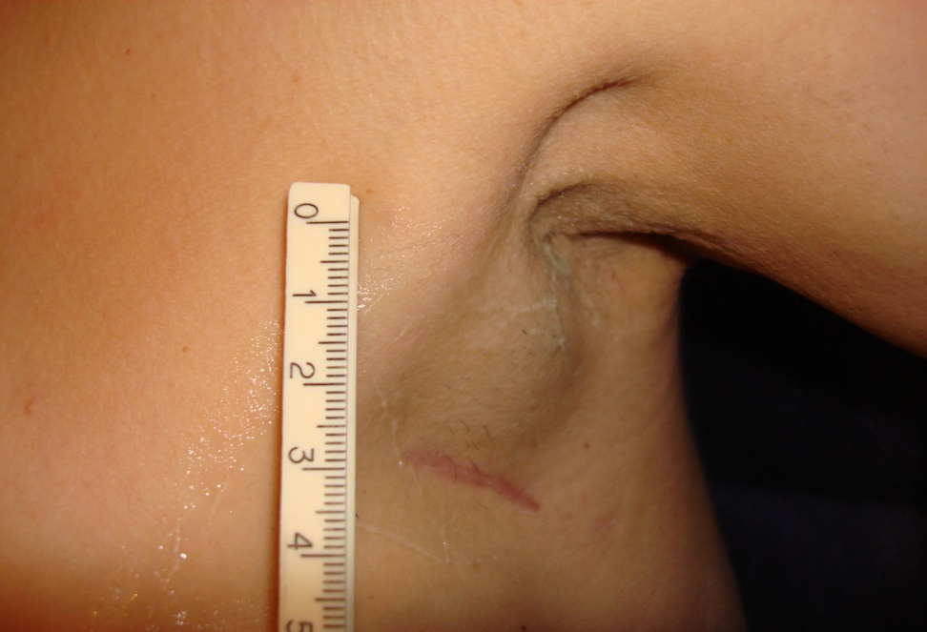
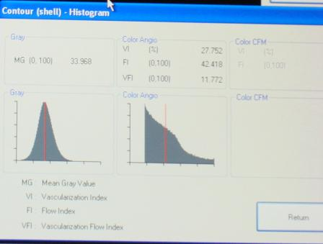
BIOPSY AXILLARY NODE
AVOID 8 CC NECROTIC AREA
Vessel
Density
27%
Vessel Density 1 %

Slide 23
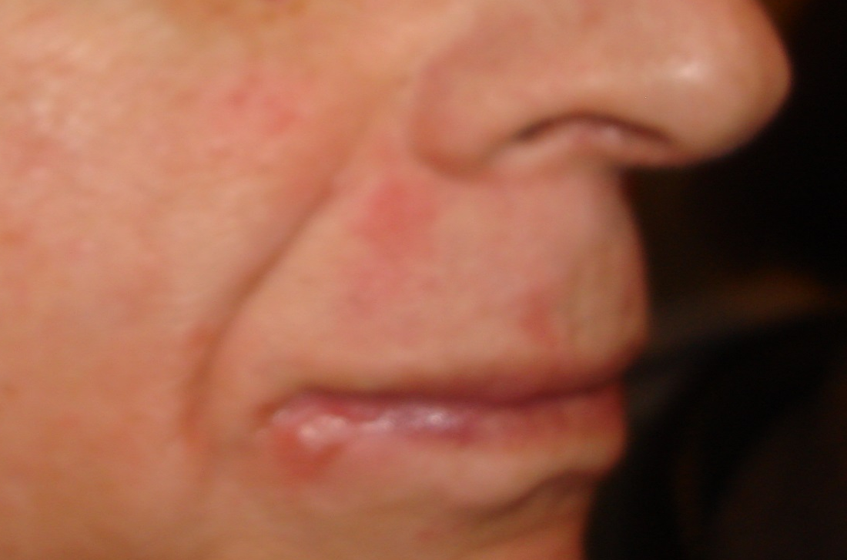
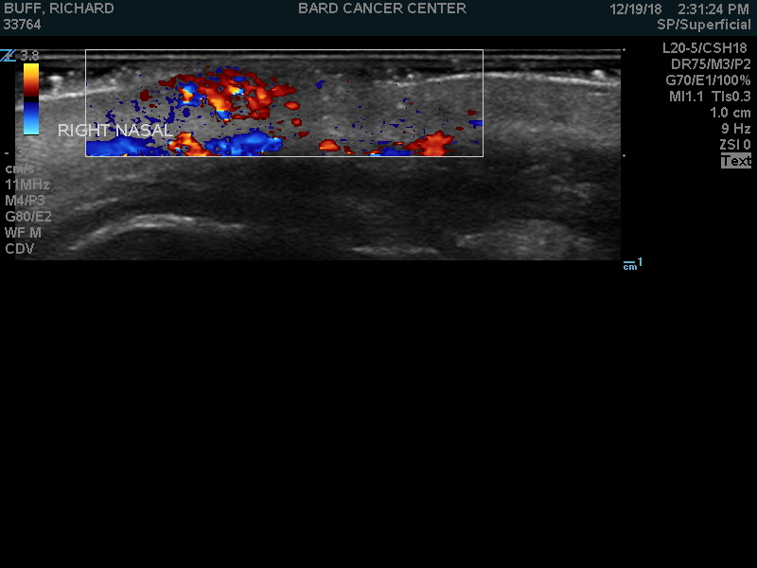
MERKEL CELL
FALSE NEGATIVE PET/CT

Slide 24
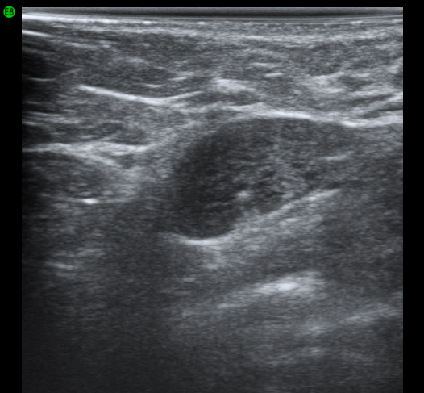
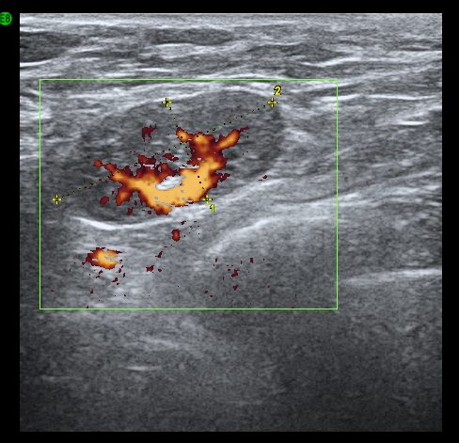
INFLAMMATORY ADENOPATHY
AXILLARY NODE ENLARGING AFTER BEE STINGS TO ARM
RIB CAGE

Slide 25
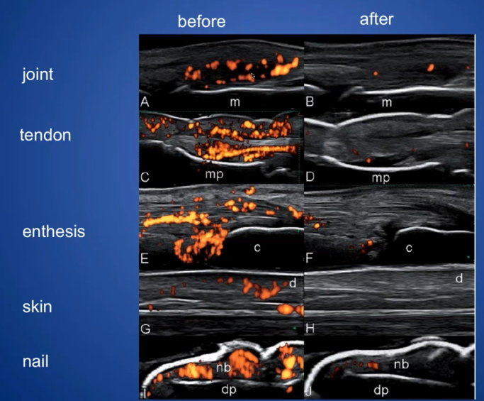
PSORIASIS TREATMENT FOLLOW-UP

Slide 26
EN FACE OCT PSORIASIS
PRE RX
VESSEL
DENSITY
PRE RX
CELL MATRIX
POST RX
VESSEL
POST RX
CELL MATRIX

Slide 27
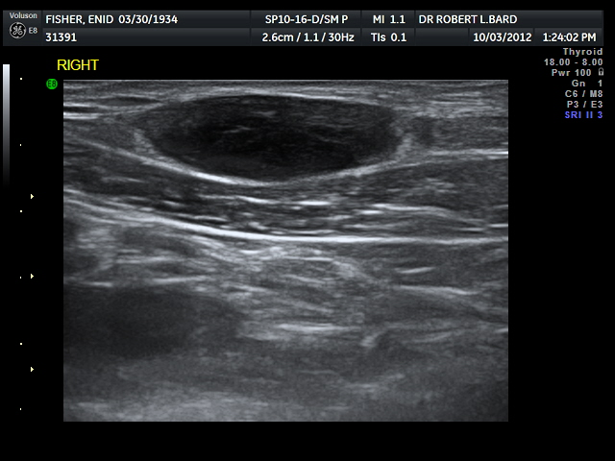
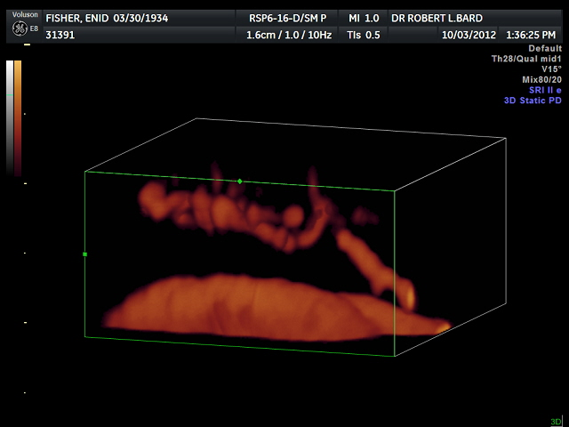
VASCULAR METASTASIS (ON BIOLOGIC THERAPY)
CLINICAL EXAM = LIPOMA SUBCLAVICULAR LOCATION PATHOLOGY=FOLLICULAR LYMPHOMA “FLORID TYPE”
NOTE VASCULAR CONNECTING VESSEL FROM SUBCLAVIAN ARTERY

Slide 28
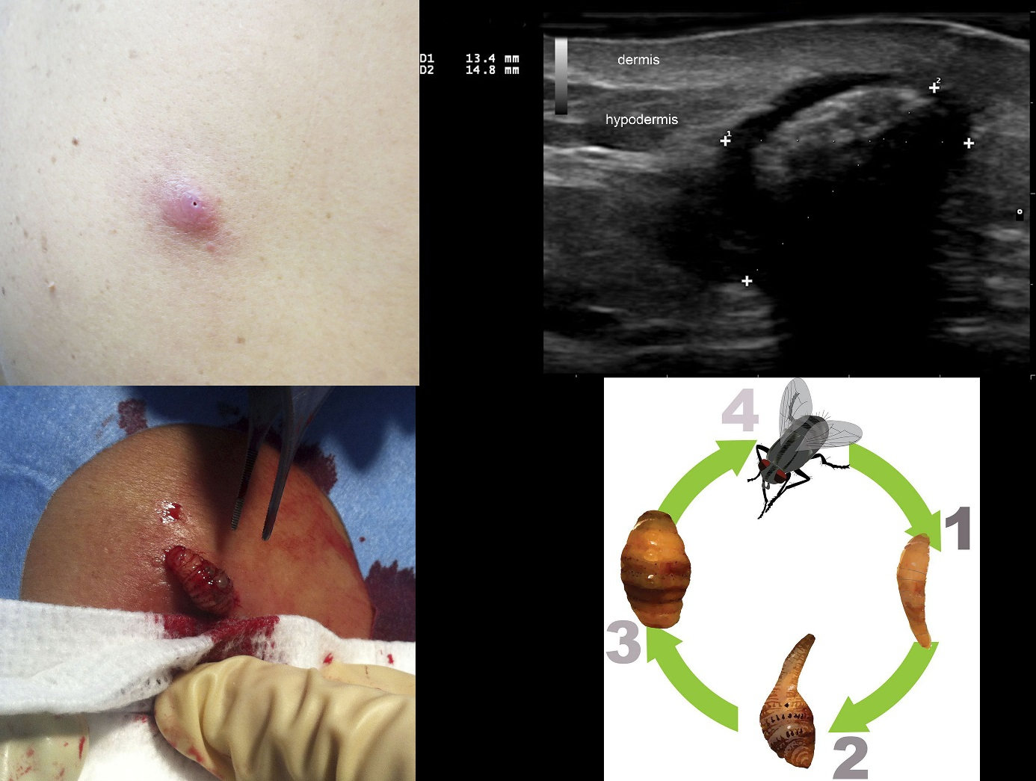
DERMATOBIA HOMINIS MYIASIS
HUMAN BOTFLY CAUSES PARASITIC SUBDERMAL INFESTATION
DOPPLER CAN SHOW MOTION OF LARVA VERIFYING VIABILITY
LARVAL IMAGE
LONGITUDINAL

Slide 29
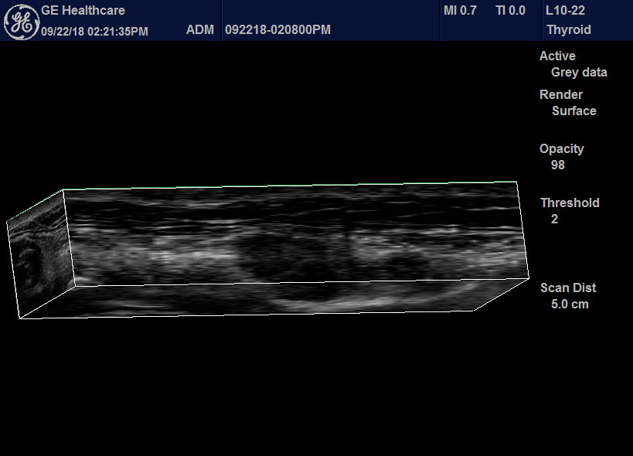

HYPERTROPHIC SCAR NECK
MULTIPLANAR RECONSTRUCTION AT 22 MH OF2.1MM SCAR (below)
Skin Scar

Slide 30


3.8 MM SCAR PRE-TREATMENT
24 MHz scan middle cord – strain elastogram blue=hard gray level above confirms

Slide 31

ELASTOGRAPHY-GREEN SOFT
(post 20 min DC current therapy)

Slide 32




POCUS VS. STAND ALONE
CLARIUS 20 MHz NECK SCAN 18 MHz SCAN 70MHz SCAN
Thyroid Cyst

Slide 33



FAT NECROSIS
SONOGRAM .5 T MRI
SONOGRAM .5 T MRI
2D
3D
T2
T1
VOLAR FOREARM 3 WEEKS POST LIPOSUCTION

Slide 34


RECURRENT NASAL BCC - 2MM
WHITE DOTS + NEOVASCULARITY = HIGH GRADE
Cartilage
Invasion

Slide 35


CHONDROSARCOMA INVADING FEMUR AND RECTUS MUSCLE
3-D Doppler of neovascularity Bone invasion arrow B-flow of tumor angiogenesis
muscle
invasion

Slide 36

FAT NECROSIS
VESSEL (RED) CORRESPONDS TO HYPEREMIA ON MRI - INFLAMMATION
SKIN MRI
humerus
HERPES VACCINE-9 MONTHS PAINLESS DEFORMITY UPPER HUMERUS

Slide 37


FAT CLOUD = EFFECTIVE TREATMENT
THERMAL INJURY CAUSING NEOVASCULARITY AND CLOUDY ECHOGENICITY

Slide 38


VASCULAR COMPROMISE
S = Silicone Oil H = Hyaluronic Acid (note two aliquots in lips)
SLIDE COURTESY OF DR XIMENA WORTSMAN SANTIAGO, CHILE

Slide 39


TOPHACEOUS GOUT
olecranon
75 y/o male with history of rheumatoid arthritis PMH episodes of gout

Slide 40


SUBDERMAL FILLER FALSE POS PET/CT SCAN
HYALURONIC FILLER 9 MONTHS BEFORE SCAN - SPO MELANOMA 9 YR

Slide 41



CELLULITIS MASKING SCC
1 mo post biopsy for AK
scc
inflammation
?abscess?
cartilage

Slide 42

SUPERFICIAL ANATOMY

Slide 43

FILLER IN ARTERY = BLINDNESS

Slide 44

MICROANATOMY

Slide 45


FOREIGN BODY 5MM SONIC SHADOW
0.2MM METALLIC INTRADERMAL
shadow
70 MHZ SHOWS STEEL FRAGMENT (WHITE) WHILE 15 MHZ ONLY SHOWS SHADOW (BLACK)

Slide 46




INTRADERMAL HEAVY METAL
2-D
3-D
HIGH
RES
SCAN
AGE
54
AGE
18
A
R
S
E
N
I
C

Slide 47


SINUS PERICRANII
MIDLINE FUSION ANOMALIES
SCALP
DEFECT
BONY CALVARIUM

Slide 48



GLANDULAR VS FIBROTIC DENSITY

Slide 49

INFLAMMATORY BREAST CA

Slide 50

Reactive benign node blue on elastogram inflammatory vessels
Normal groin artery & vein mass decreased 80% absent vessels

Slide 51


AUTO-FLUORESCENCE BURN

Slide 52

PET/CT OF RECURRENT SCC
LOCAL UNIVERSITY HOSPITAL RECOMMENDED AK AMPUTATION

Slide 53
GLOMUS TUMOR
ERYTHRONYCHIA 5 YRS
CURVILINEAR BONEY REMODELLING HYPEREMIA
SONOGRAM DOPPLER SCAN

Slide 54


CHRONIC PSORIASIS
DERMIS
olecranon
(1) NORMAL DERMIS = 1 MM (2) THICKENED DERMIS = 3 MM

Slide 55
PSORIASIS TREATMENT FOLLOW-UP

Slide 56

PSORIATIC VESSEL DENSITY
INFLAMATORY VESSEL DENSITY=9.6 % MAY BE FOLLOWED DURING THERAPY

Slide 57


PSEUDOXANTHOMA ELASTICUM
NORMAL SKIN 1.0 MM AVASCULAR LESION DEPTH 1.7 MM

Slide 58


BCC INVADING BONE
FOLLOWING SLIDES : CATALANO/BARD J ULTRASOUND MED 2019 (in press)
T
T
CORTEX

Slide 59


BCC NASAL ALA SPARES CARTILAGE

Slide 60



7mm DEPTH: SCC SPARES CARTILAGE

Slide 61

MALIGNANT MELANOMA

Slide 62

ACRAL MELANOMA (same case)
TUMOR
METATARSAL

Slide 63

DOPPLER ACRAL MELANOMA (same case)
DERMIS
HIGH
DOPPLER
VESSELS
LOW
FLOW

Slide 64

RECURRENT DFSP (adjacent to frontal bone)
FRONTAL SINUS

Slide 65


KAPOSI’S SARCOMA

Slide 66

OCT ANATOMY - 1.5 mm DEPTH SCAN
epidermis
HAIR FOLLICLE
SEBACEOUS
GLAND

Slide 67

ANGIOMA: DERMOSCOPY VS ANGIO-OCT
Nd: YAG
Pre treatment
Post treatment
Courtesy: Prof. Welzel in Bard Ed: IMAGE GUIDED DERMATOLOGIC TREATMENT (Springer 2020)

Slide 68

BCC: DERMOSCOPY VS ANGIO OCT & OCT

Slide 69

OCT: SCC NEOVASCULARITY EN FACE
Nd: YAG
DAY 0
DAY 7

Slide 70
MICROVASCULAR IMAGING
ROBERT BARD, MD, DABR, FAIUM, FASLMS
Director, Bard Diagnostics
THE ANGIOFOUNDATION 501(c)3, NYC
Founder
SOCIETE FRANCAISE DE RADIOLOGIE, PARIS
International Contributor

